Slide 1
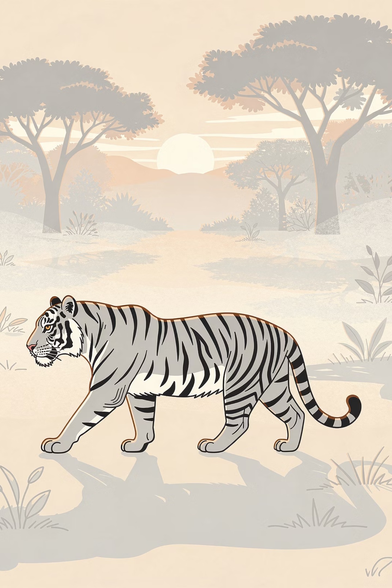
Wildlife Protection in India: Safeguarding Our Natural Heritage
India's rich biodiversity is a testament to nature's grandeur. From the Bengal tiger's prowl to the Asiatic lion's roar, our wildlife represents an irreplaceable natural treasure that demands protection and reverence.
Berojghar team

Slide 2





FUNDAMENTALS
What is Wildlife?
Wild Animals & Birds
Native Flora
Aquatic Life
All undomesticated creatures living freely in their natural habitats, from mighty elephants to delicate butterflies.
Indigenous plants and trees that form the foundation of ecosystems, excluding cultivated agricultural species.
Marine and freshwater species thriving in rivers, lakes, and oceans across India's diverse water bodies.
The Wildlife Protection Act, 1972 provides the legal definition, covering species like tigers, elephants, lions, and native flora while excluding domesticated animals and cultivated plants.
Berojghar team

Slide 3
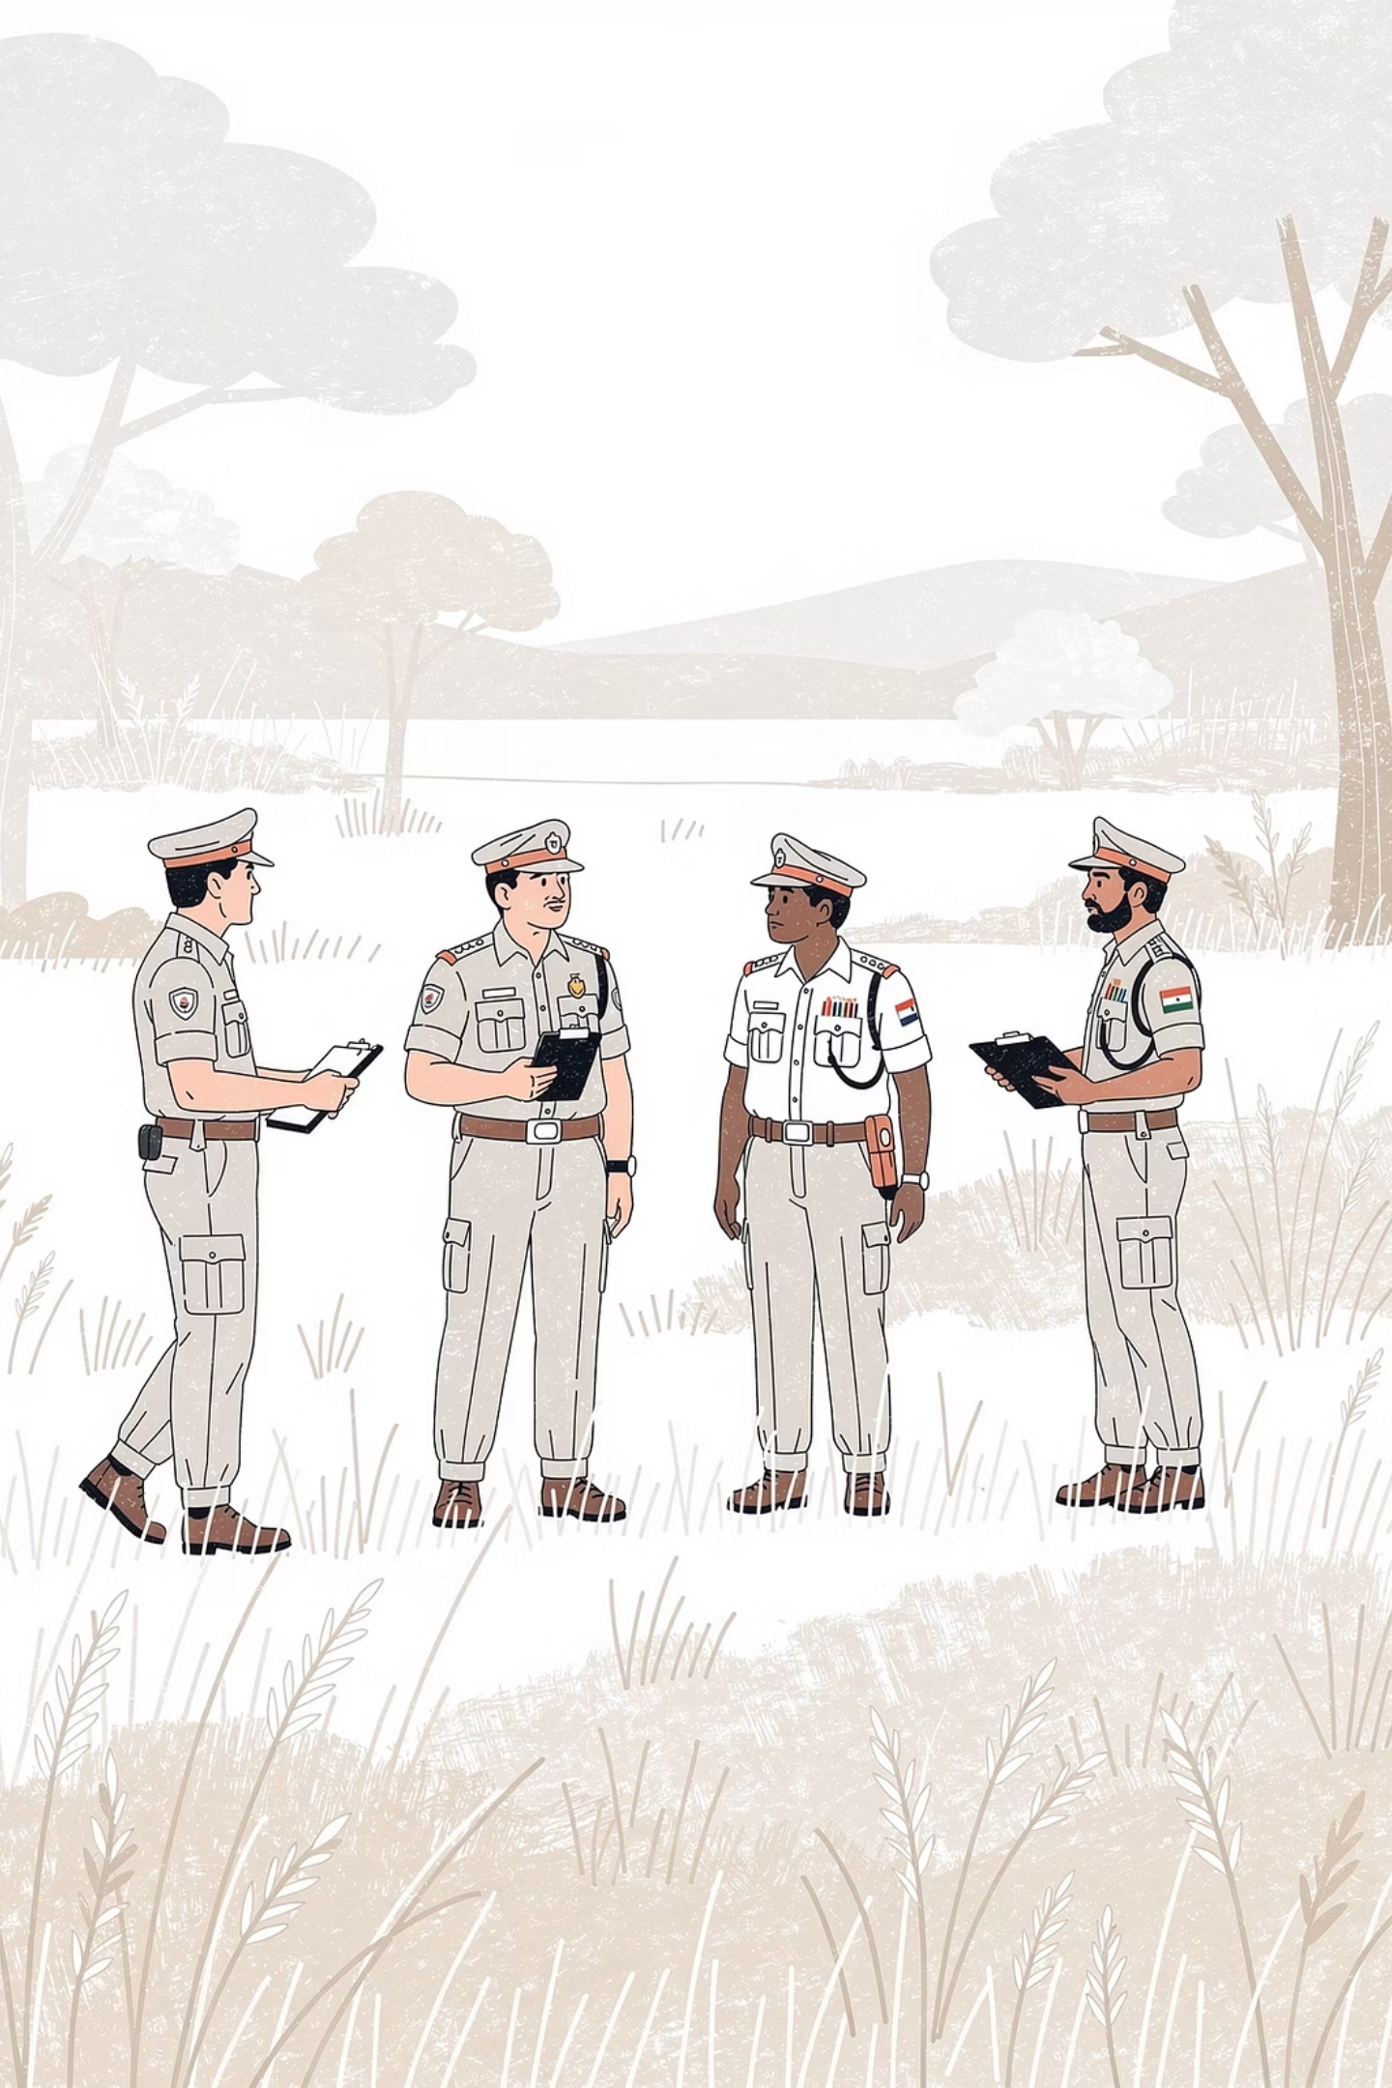

CONSERVATION IMPERATIVE
Why Protect Wildlife?
Ecological Significance
Human Benefits
Maintains delicate ecological balance and biodiversity
Economic value through eco-tourism generating billions
Supports critical food chains and nutrient cycles
Medicinal resources from plants and organisms
Sustainable livelihoods for local communities
Ensures ecosystem stability and resilience
Cultural heritage and national pride
Regulates climate through carbon sequestration
60%
500+
World's Wild Tigers
Asiatic Lions
India is home to 60% of the global wild tiger population, showcasing successful conservation efforts.
The only remaining wild population of Asiatic lions exists exclusively in India's Gir Forest.
Berojghar team

Slide 4
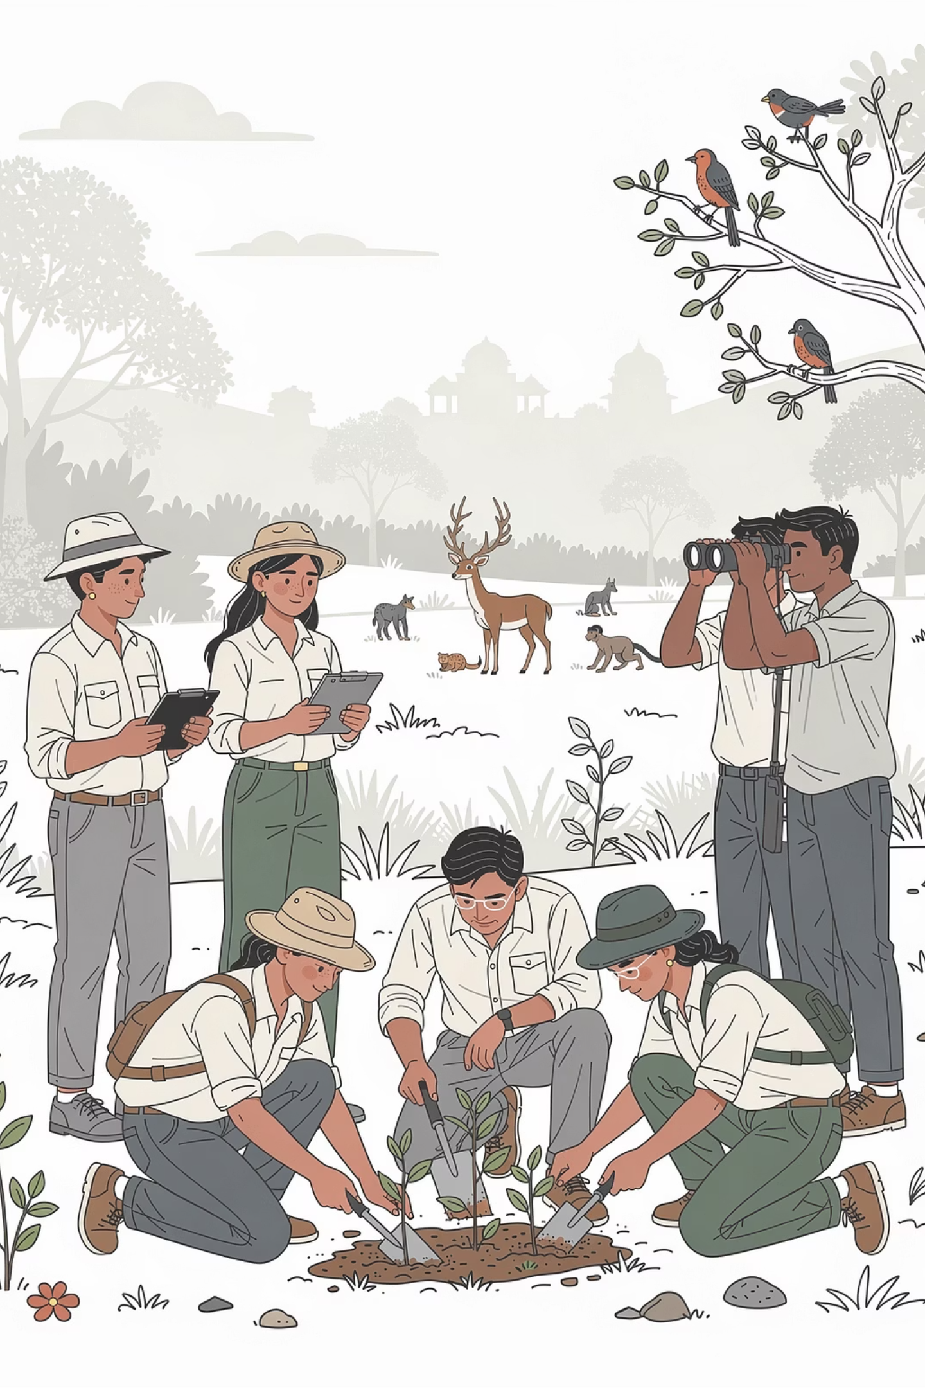
CRITICAL THREATS
Major Threats to Wildlife in India
Habitat Loss
Poaching & Illegal Trade
Rapid urbanization, deforestation, and industrial expansion are fragmenting and destroying natural habitats at an alarming rate, leaving wildlife with nowhere to thrive.
A multi-billion dollar criminal enterprise targeting elephants for ivory, rhinos for horns, and tigers for body parts, pushing species toward extinction.
Environmental Pollution
Air, water, and soil contamination from industrial waste and chemicals is poisoning habitats and disrupting reproductive cycles of countless species.
Invasive Species
Non-native plants and animals disrupting delicate ecosystem balances and outcompeting indigenous species for resources.
Climate Change
Rising temperatures and shifting weather patterns are altering habitats, affecting migration routes, and threatening species survival.
Berojghar team

Slide 5
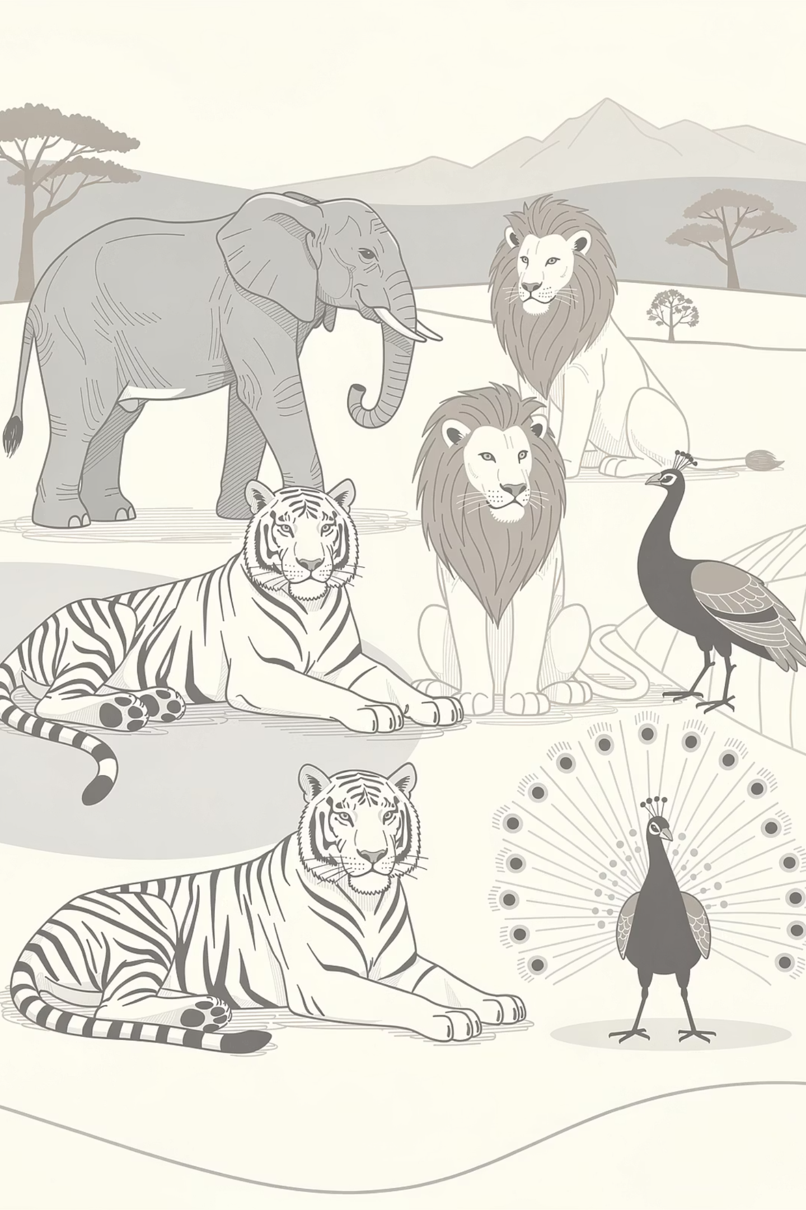

LEGAL FRAMEWORK
The Wildlife Protection Act, 1972
A landmark legislation that revolutionized wildlife conservation in India, providing comprehensive legal protection and establishing the foundation for modern conservation efforts.
01
Protection Framework
Establishes six schedules categorizing species by protection level, from absolute protection to regulated hunting permissions.
02
Hunting Prohibition
Strictly prohibits hunting of endangered species except under exceptional scientific or educational circumstances with government approval.
03
Protected Areas
Empowers central and state governments to designate and manage national parks, sanctuaries, and conservation reserves.
04
Trade Regulation
Controls and monitors trade in wildlife products, implementing CITES agreements and preventing illegal trafficking.
Berojghar team

Slide 6
Protected Areas: Sanctuaries of Biodiversity
Jim Corbett National Park
Kaziranga National Park
Gir National Park
Established in 1936, India's first national park pioneered wildlife conservation and remains a premier tiger reserve.
UNESCO World Heritage Site protecting two-thirds of the world's great one-horned rhinoceros population.
The last refuge of the Asiatic lion, safeguarding this majestic species from extinction through dedicated conservation.
166
490+
National Parks
Wildlife Sanctuaries
Across India
Protected zones
These protected areas preserve critical habitats, provide safe breeding grounds, and support species recovery programs like Project Tiger and the Gir Lion Project, which focus specifically on recovering tiger and lion populations.
Berojghar team

Slide 7

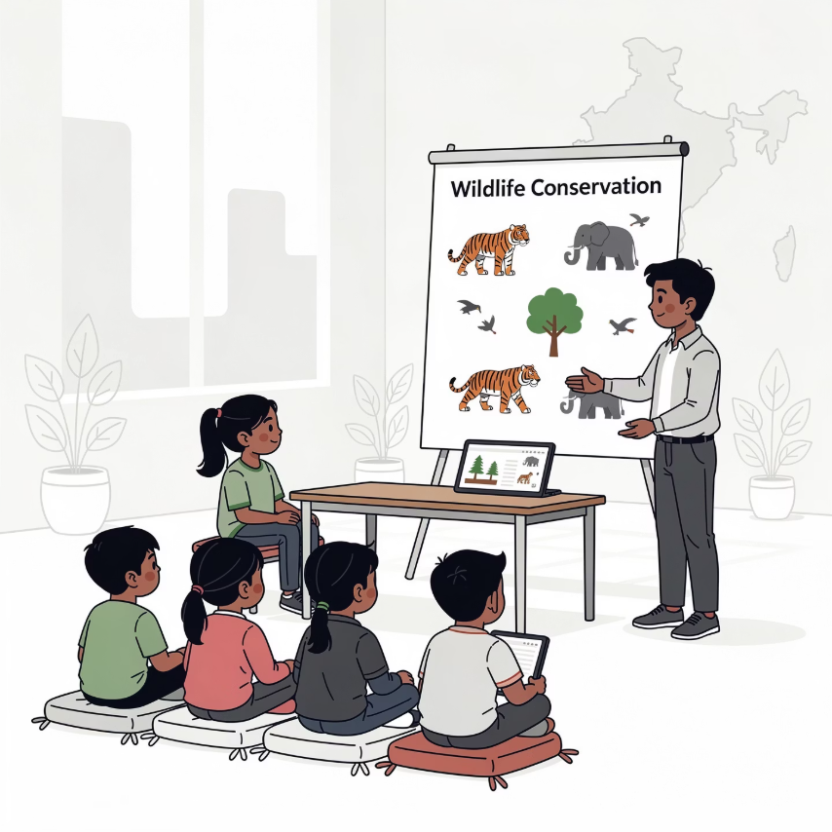
CONSERVATION WINS
Success Stories in Wildlife Protection
Tiger Triumph
Lion Legacy
Community Conservation
From the brink of extinction with under 2,000 tigers in the early 2000s, India's tiger population has rebounded spectacularly to over 3,000 by 2025 through Project Tiger initiatives.
Gir National Park's dedicated conservation efforts saved the Asiatic lion from near extinction, growing the population from double digits to over 500 individuals.
Innovative programs involving local communities as wildlife guardians have created sustainable livelihoods while protecting habitats, proving conservation and development can coexist.
Inspiring the Next Generation
Education programs like Wild Shaale are empowering youth with knowledge and passion for biodiversity protection. These initiatives are creating a generation of conservation champions who understand the intrinsic value of wildlife and are committed to its preservation.
Berojghar team

Slide 8
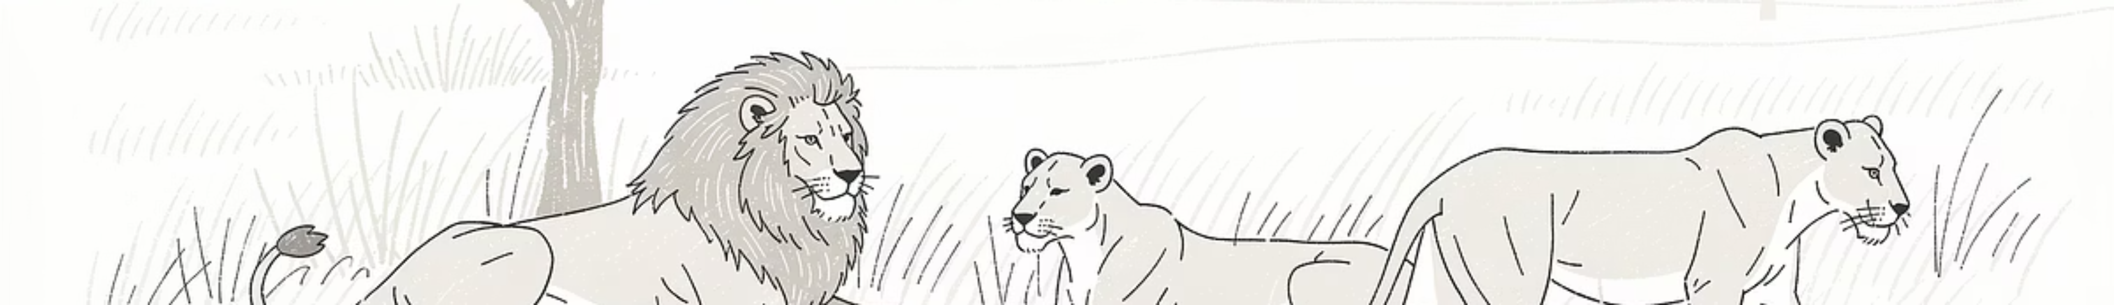



ONGOING CHALLENGES
Challenges Ahead
Habitat Fragmentation
Human-Wildlife Conflict
Enforcement Gaps
Infrastructure development continues to slice through wildlife corridors, isolating populations and limiting genetic diversity.
Expanding human settlements are encroaching on wildlife territories, leading to increased confrontations and casualties on both sides.
Despite strong laws, enforcement against poaching and illegal trade requires more resources, technology, and coordination.
Climate Change: The Invisible Threat
Rising temperatures and unpredictable weather patterns are forcing species to adapt faster than evolution allows. Adaptive conservation strategies incorporating climate resilience are essential for long-term wildlife survival.
Berojghar team

Slide 9





TAKE ACTION
How You Can Help
Wildlife conservation isn't just the government's responsibility—every citizen can contribute to protecting India's natural heritage. Small actions collectively create massive impact.
Support Eco-Tourism
Spread Awareness
Choose responsible wildlife experiences that fund conservation and provide sustainable income to local communities. Your tourism rupees become conservation dollars.
Educate others about wildlife laws, conservation needs, and the importance of biodiversity. Share knowledge through social media, schools, and community groups.
Participate & Support
Advocate for Policy
Join or donate to local conservation initiatives, wildlife NGOs, and community-based protection programs working on the ground.
Support policies that balance development with wildlife protection. Engage with local representatives to prioritize sustainable growth over unchecked expansion.
Berojghar team

Slide 10


Protecting India's Wildlife is Protecting Our Future
A Priceless Heritage
Our Collective Responsibility
Wildlife represents more than just animals and plants—it embodies our natural heritage, ecological health, and the intricate web of life that sustains humanity itself.
The survival of India's majestic species depends on actions we take today. Every effort, no matter how small, contributes to ensuring future generations inherit a world where wild wonders still thrive.
Together, We Can Keep India's Wild Wonders Alive
The roar of the tiger, the trumpet of the elephant, the majesty of soaring eagles—these sounds and sights are irreplaceable. Our commitment to conservation today determines whether they echo through eternity or fade into silence.
Berojghar team

